Slide 1
Spring Security
Truong Nhat Hoang – 51703092
Huynh Van Duy – 51703006
Tran Quoc Linh - 51703124

Slide 2

What is Spring Security?
Spring Security is a Java/Java EE framework that provides authentication, authorization and other security features for enterprise applications.

Slide 3
Feature
Comprehensive and extensible support for both Authentication and Authorization
Protection against attacks like session fixation, clickjacking, cross site request forgery, etc.
Servlet API integration
Optional integration with Spring Web MVC
…

Slide 4
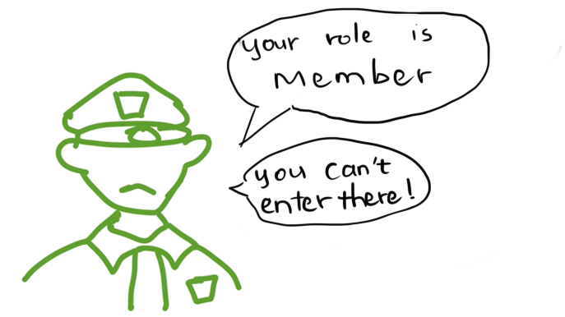
When do we use?
Base on spring security feature, we can use it when we want to hide certain links or buttons based on user’s role so that they will not be able to access that functionality.

Slide 5
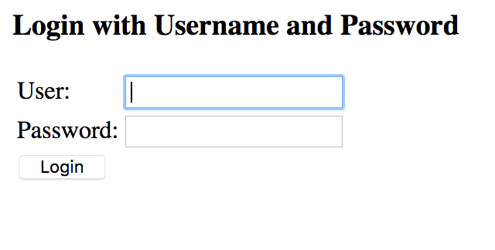
Where do we use?
Spring security can be used for authentication and authorization purposes in your application (such as login). You can secure you app with it. Authenticate user for web apps, mobile apps, etc. It provides integration with LDAP as well.

Slide 6
Why spring-security?
Spring Security fill a gap in the universe of Java third-party libraries. Standards such as Java Authentication and Authorization Service ( JAAS ) or Java EE Security do offer some ways of performing some of the same authentication and authorization functions, but Spring Security includes everything you need to implement a top-to-bottom application security solution in a concise and sensible way.

Slide 7
Why spring-security?
Additionally, Spring Security offers out-of-the-box integration with many common enterprise authentication systems; so it's adaptable to most situations with little effort (beyond configuration) on the part of the developer.
There's really no other mainstream framework good like it!

Slide 8
Build a simple security
web application

Slide 9
Requirements and start the project
Requirement
JDK 1.8 or later
Gradle 4+ or Maven 3.2+
Then, starting with Spring Initializr

Slide 10
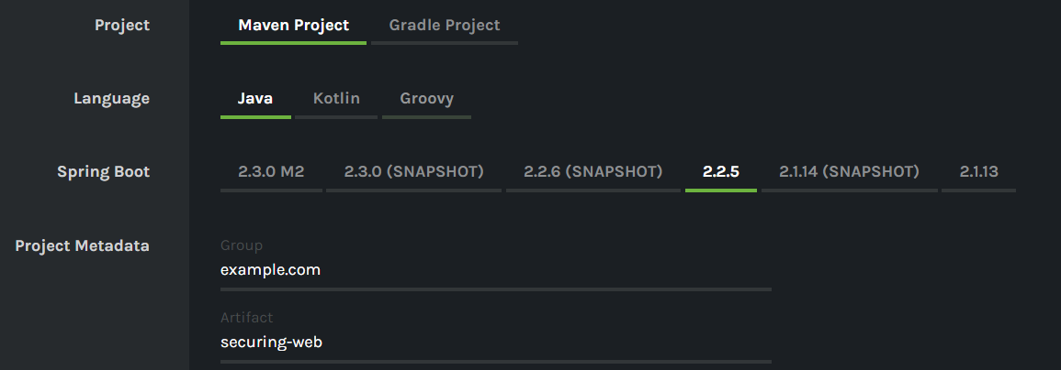
Start with Spring Initializr
Select compatible options with your environment

Slide 11
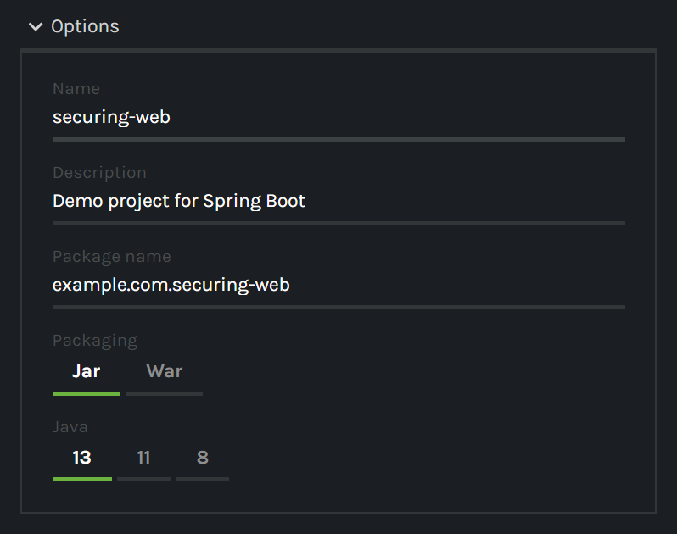
Start with Spring Initializr
Select compatible options with your environment

Slide 12
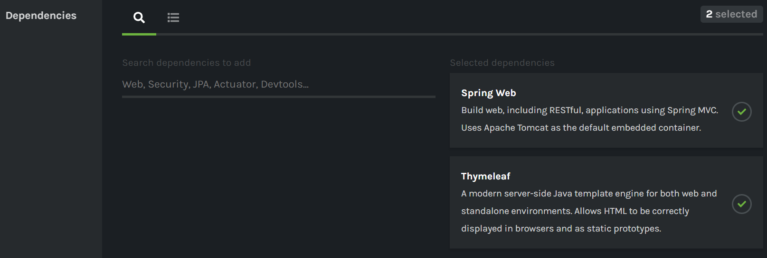
Start with Spring Initializr
Add two dependence
Then click on generate button

Slide 13
Create an Unsecured Web Application
Create two HTML files (home.html and hello.html) follow path
src/main/resources/templates/home.html
src/main/resources/templates/hello.html
<!DOCTYPE html>
<html xmlns="http://www.w3.org/1999/xhtml" xmlns:th="https://www.thymeleaf.org" xmlns:sec="https://www.thymeleaf.org/thymeleaf-extras-springsecurity3">
<head>
<title>Spring Security Example</title>
</head>
<body>
<h1>Welcome!</h1>
<p>Click <a th:href="@{/hello}">here</a> to see a greeting.</p>
</body>
</html>
<!DOCTYPE html>
<html xmlns="http://www.w3.org/1999/xhtml" xmlns:th="https://www.thymeleaf.org" xmlns:sec="https://www.thymeleaf.org/thymeleaf-extras-springsecurity3">
<head>
<title>Hello World!</title>
</head>
<body>
<h1>Hello world!</h1>
</body>
</html>
hello.html
home.html

Slide 14
Create an Unsecured Web Application
And a MvcConfig.java file from src/main/java/com/example/securingweb/MvcConfig.java
package com.example.securingweb;
import org.springframework.context.annotation.Configuration;
import org.springframework.web.servlet.config.annotation.ViewControllerRegistry;
import org.springframework.web.servlet.config.annotation.WebMvcConfigurer;
@Configuration public class MvcConfig implements WebMvcConfigurer {
public void addViewControllers(ViewControllerRegistry registry) {
registry.addViewController("/home").setViewName("home");
registry.addViewController("/").setViewName("home");
registry.addViewController("/hello").setViewName("hello");
registry.addViewController("/login").setViewName("login");
}
}

Slide 15
Set up Spring Security
Add two extra entries (one for the application and one for testing) to the <dependencies> element in pom.xml
<dependency>
<groupId>org.springframework.boot</groupId>
<artifactId>spring-boot-starter-security</artifactId>
</dependency>
<dependency>
<groupId>org.springframework.security</groupId>
<artifactId>spring-security-test</artifactId>
<scope>test</scope>
</dependency>

Slide 16
Set up Spring Security
Create login.html file and modify hello.html
<!DOCTYPE html>
<html xmlns="http://www.w3.org/1999/xhtml" xmlns:th="https://www.thymeleaf.org" xmlns:sec="https://www.thymeleaf.org/thymeleaf-extras-springsecurity3">
<head> <title>Spring Security Example </title> </head>
<body>
<div th:if="${param.error}"> Invalid username and password. </div>
<div th:if="${param.logout}"> You have been logged out. </div>
<form th:action="@{/login}" method="post">
<div><label> User Name : <input type="text" name="username"/> </label></div>
<div><label> Password: <input type="password" name="password"/> </label></div>
<div><input type="submit" value="Sign In"/></div>
</form>
</body>
</html>
<!DOCTYPE html>
<html xmlns="http://www.w3.org/1999/xhtml" xmlns:th="https://www.thymeleaf.org" xmlns:sec="https://www.thymeleaf.org/thymeleaf-extras-springsecurity3">
<head> <title>Hello World!</title> </head>
<body>
<h1 th:inline="text">Hello [[${#httpServletRequest.remoteUser}]]!</h1>
<form th:action="@{/logout}" method="post">
<input type="submit" value="Sign Out"/>
</form>
</body>
</html>
hello.html
login.html

Slide 17
Set up Spring Security
Then add two java file below to path src/main/java/com/example/securingweb/
WebSecurityConfig.java (file attach)
SecuringWebApplication.java (file attach)
You need not to modify them.

Slide 18
Run the Application
Open cmd and cd to project folder. Using one of following to build an executable JAR
mvnw spring-boot:run
mvnw clean package
Then, run jar just build with
java –jar target/<filename>.jar
Finally, open browser with url http://localhost:8080/ to see the result.

Slide 19
Advantages and disadvantages
Advantages:
It is very easy to develop Spring Based applications with Java or Groovy.
It reduces a lot of development time and increases productivity.
It avoids writing of boilerplate Code, Annotations and XML Configuration.
It is very easy to integrate Spring Boot Application with its Spring Ecosystem like Spring JDBC, Spring ORM, Spring Data, Spring Security etc.

Slide 20
Advantages and disadvantages
Advantages:
It follows “Opinionated Defaults Configuration” Approach to reduce Developer effort
It provides Embedded HTTP servers like Tomcat, Jetty etc. to develop and test our web applications very easily.
It provides CLI (Command Line Interface) tool to develop and test Spring Boot (Java or Groovy) Applications from command prompt very easily and quickly.
It provides lots of plugins to develop and test Spring Boot Applications and it uses Build Tools like Maven and Gradle
It provides lots of plugins to work with embedded and in-memory Databases very easily.

Slide 21
Advantages and disadvantages
Disadvantages:
It is very tough and time consuming process to convert existing or legacy Spring Framework projects into Spring Boot Applications. It is applicable only for brand new/Greenfield Spring Projects.

Slide 22
References i
[1] https://spring.io/projects/spring-security
[2] https://en.wikipedia.org/wiki/Spring_Security
[3] https://www.youtube.com/watch?v=sm-8qfMWEV8
[4] Mick Knutson, Robert Winch, Peter Mularien - Spring Security-Packt Publishing (2017)

Slide 23
References ii
[5] https://kipalog.com/posts/Huong-dan-lap-trinh-Spring-Security
[6] https://www.developer.com/java/ent/what-is-spring-security.html
[7] https://spring.io/guides/gs/securing-web/

Slide 24
Thanks

